Slide 1
Initial Expedition Training Learning Outcomes 2 and 3 Camp Craft
Uncontrolled copy not subject to amendment
Version 2.0 OCT 2014

Slide 2
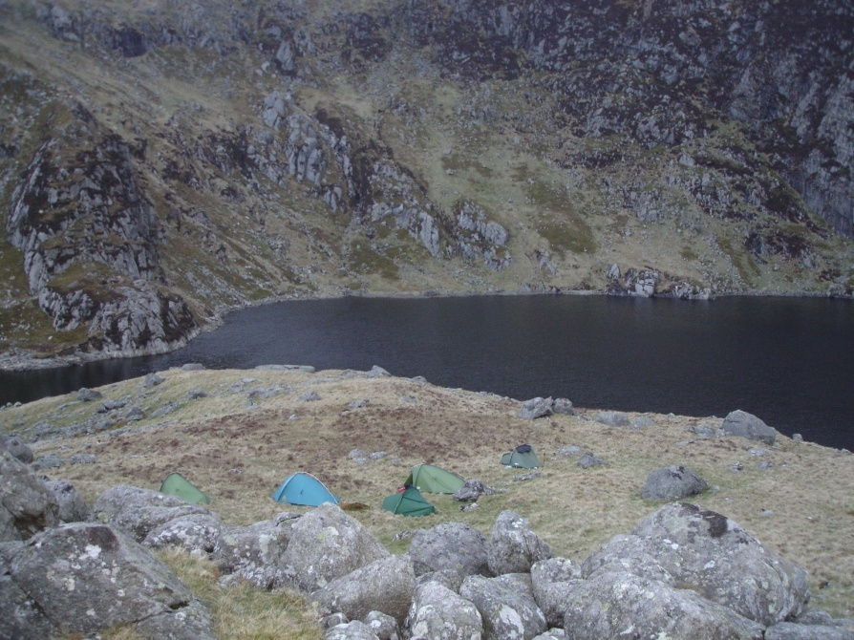
A place to camp – in the wild
In wild country
Camping here looked like this!

Slide 3
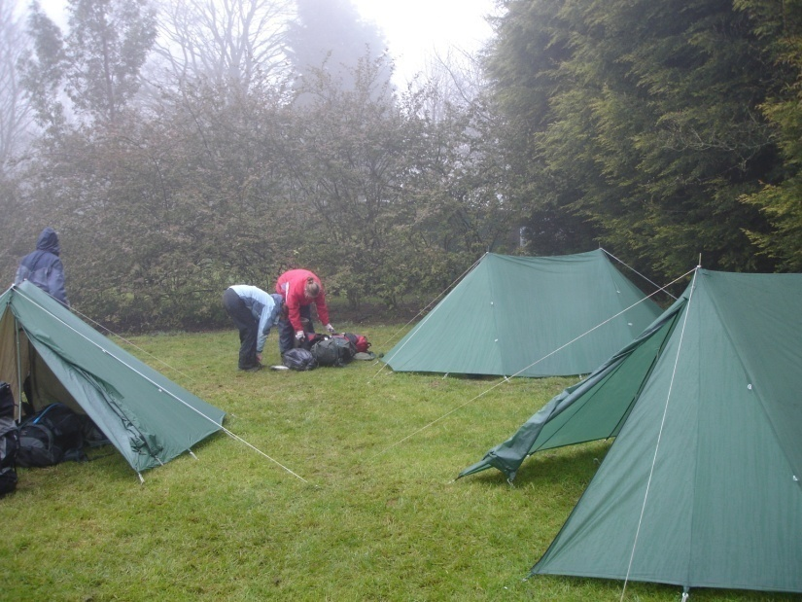
A place to camp –
commercial site
Commercial campsites are often on the map
This one has a website on line

Slide 4
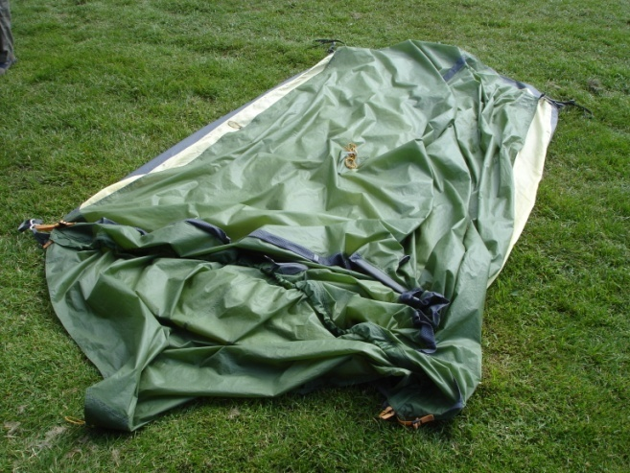
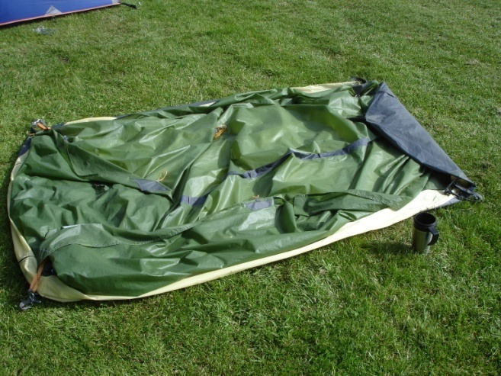
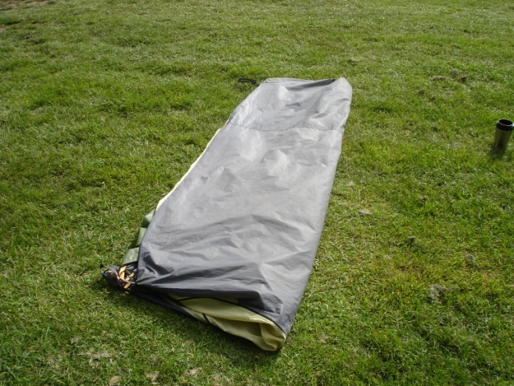
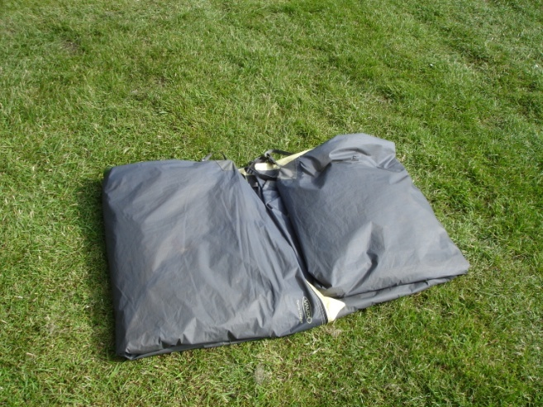
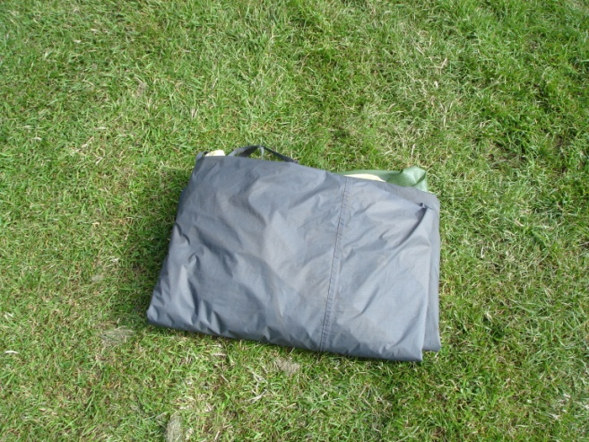
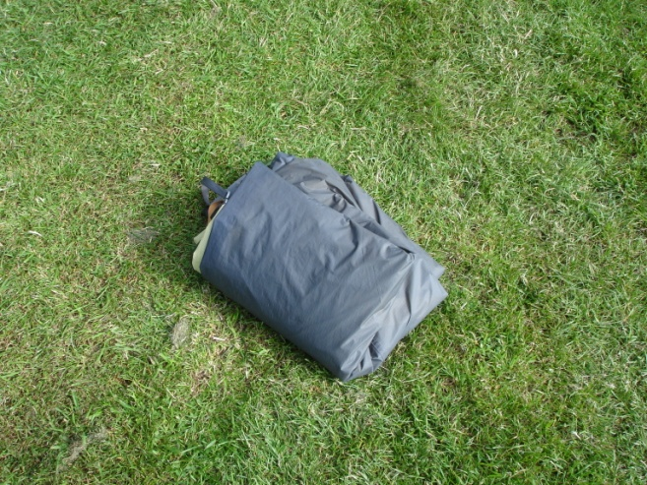
Packing away the tent

